Slide 1


E-COMMERCE PROGRESS

Slide 2
TOPICS
EC E-COMMERCE
SOCIAL MEDIA
MOBILE APPS

Slide 4
EC E-COMMERCE SCOPE OF WORK
SOCIAL MEDIA | PKS DEALING | PAYMENT/REFINANCING | SERVER | SYSTEM DEV.
SOCIAL MEDIA DAILY | JNE | JATIS | SERVER MANTAINANCE | SYSTEM SECURITIES
SOCIAL MEDIA EVENT | BCA CC | KREDITPLUS | SERVER SECURITIES | SYSTEM DEVELOPMENT
SOCIAL MEDIA STRATEGY | SSL |  | SERVER TWEAKING | PAYMENT GATEWAY INTEGRATION
SOCIAL MEDIA PROMOTION |  |  | SERVER MONITORING | LAYOUT OPTIMIZING
- REAL STORE |  |  |  | SEO
- WEBSTORE |  |  |  | SMO
SOCIAL MEDIA SUPPORT |  |  |  | SYSTEM MONITORING
- REAL STORE |  |  |  | SSL INTEGRATION
- WEBSTORE |  |  |  | PAYMENT SECURITIES
OUT LINKING |  |  |  | BANNER MANAGEMENT
 |  |  |  | STORE LOCATOR MANAGEMENT

Slide 5
IDEAS
Product banyak di search :
AC
Referigerator (Kulkas)
Gadget And Handphones (Diperbanyak Items)
LED and LCD
Home Theater
Product di show di webstore tanpa harus TO items di maris
Ongkos kirim jabodetabek gratis
Concern : canibalize
Harga di web biasanya lebih murah dari real store
Product Review diperlengkap

Slide 6
ELECTRONIC-CITY.NET

Slide 7
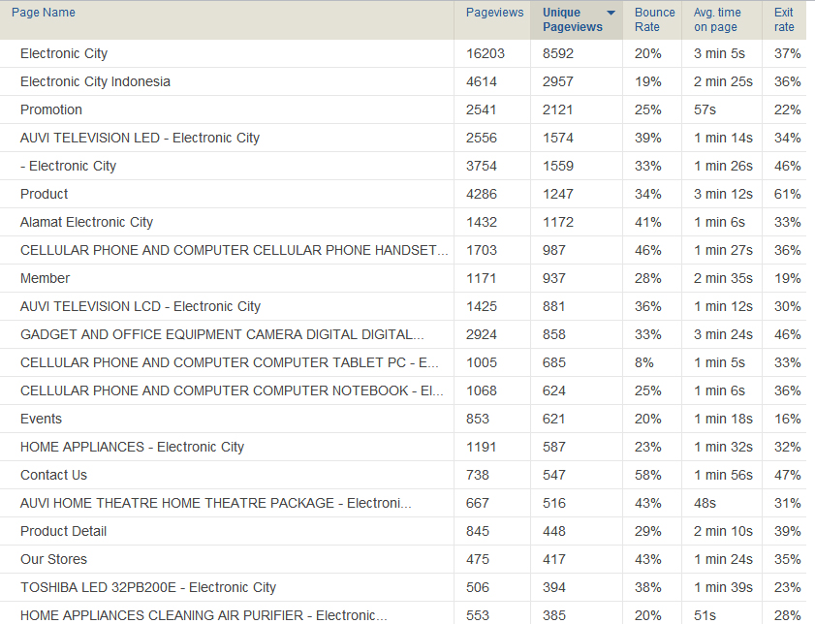

Slide 8
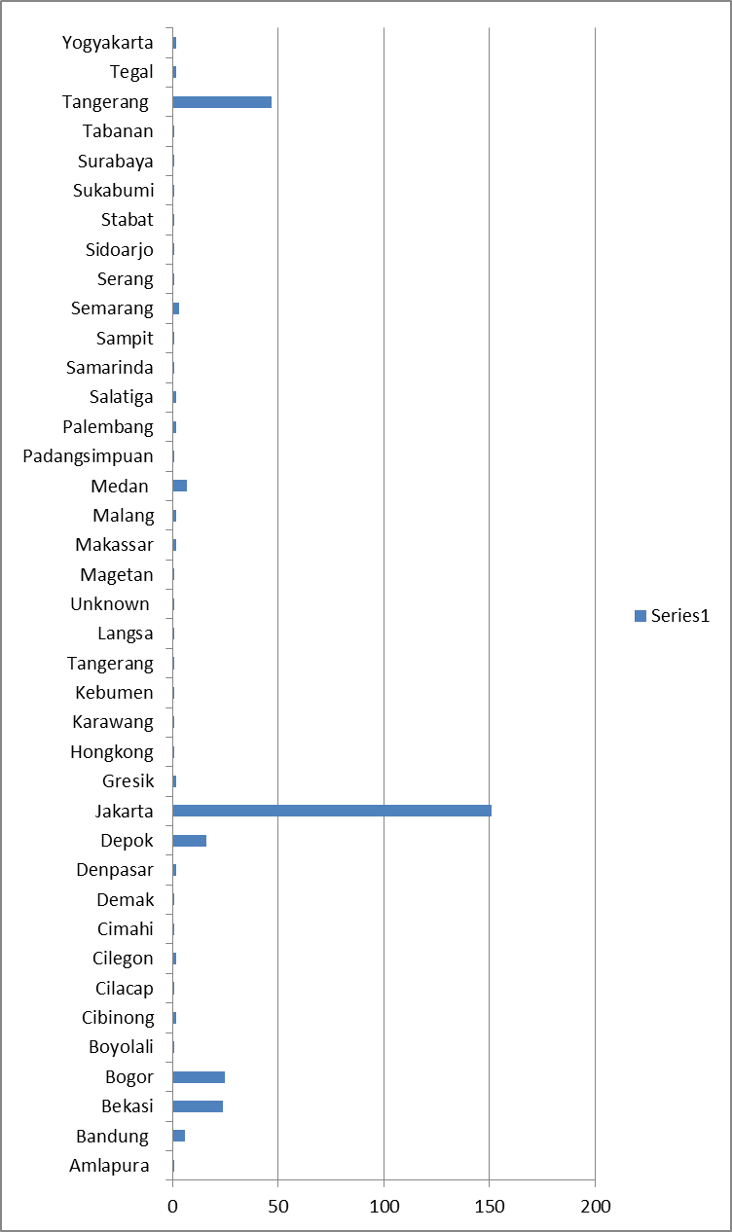
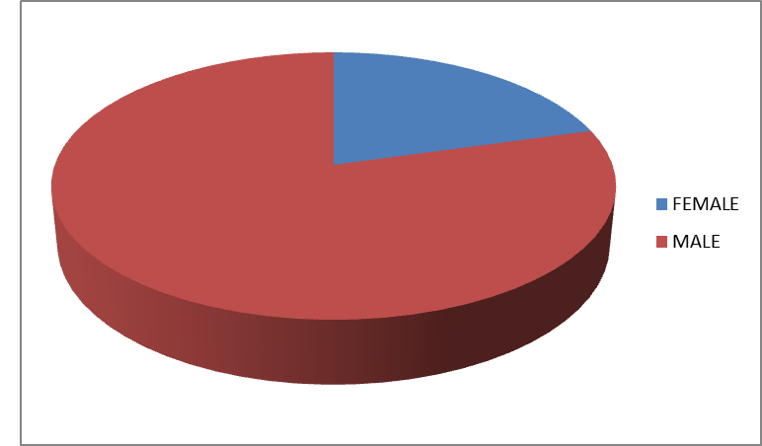
EC WEBSTORE MEMBERS
TOTAL : 560

Slide 9
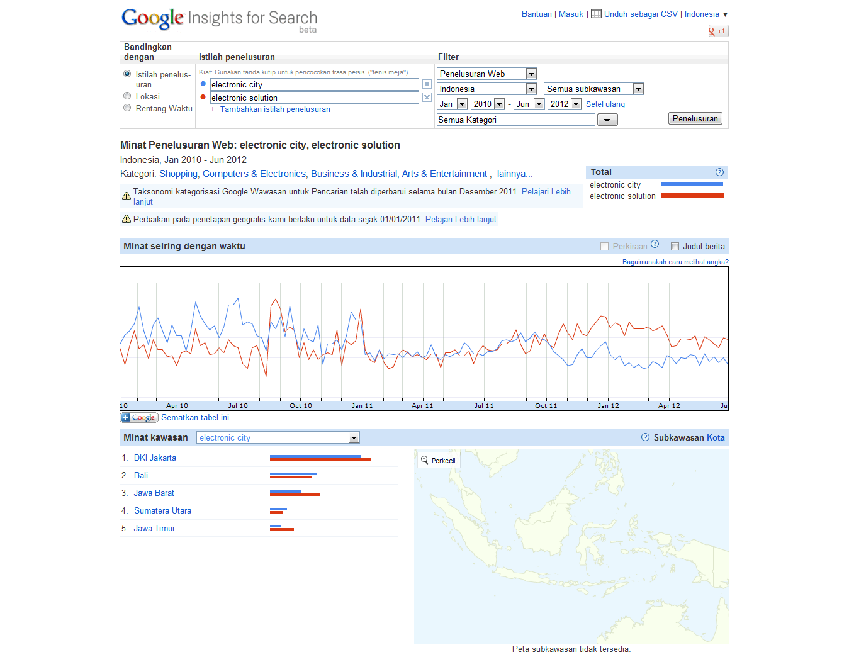
INTERNET BRANDING BEFORE

Slide 10
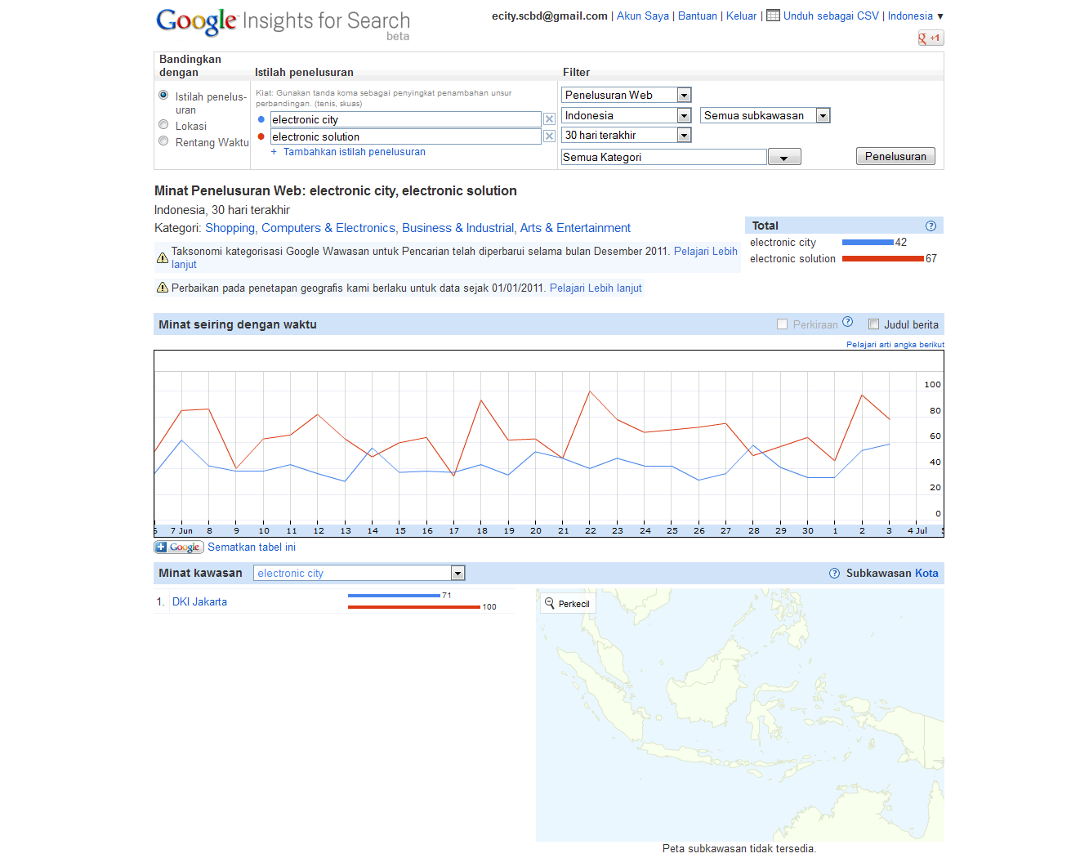
INTERNET BRANDING CURRENT

Slide 11
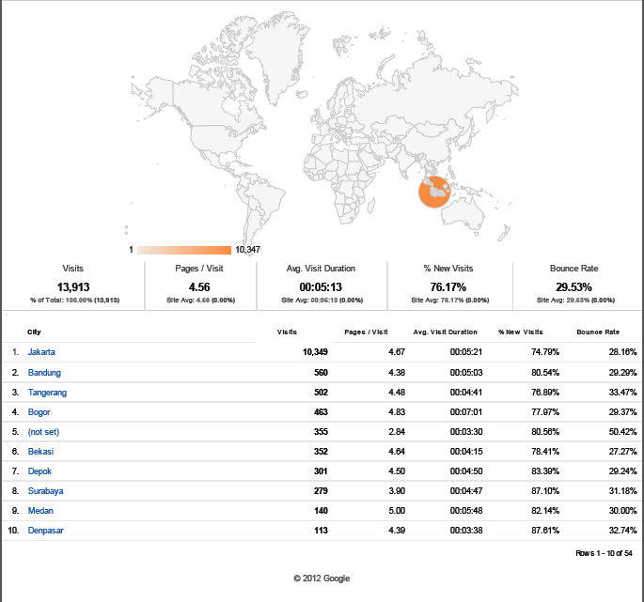
EC WEBSTORE VISITORS

Slide 12
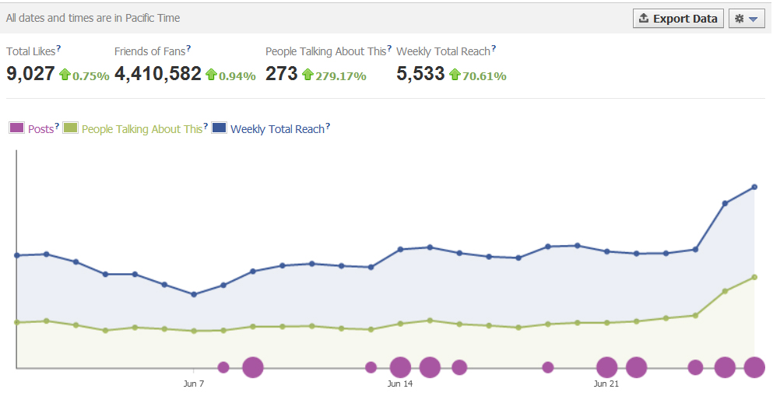
FACEBOOK GROWTH

Slide 13
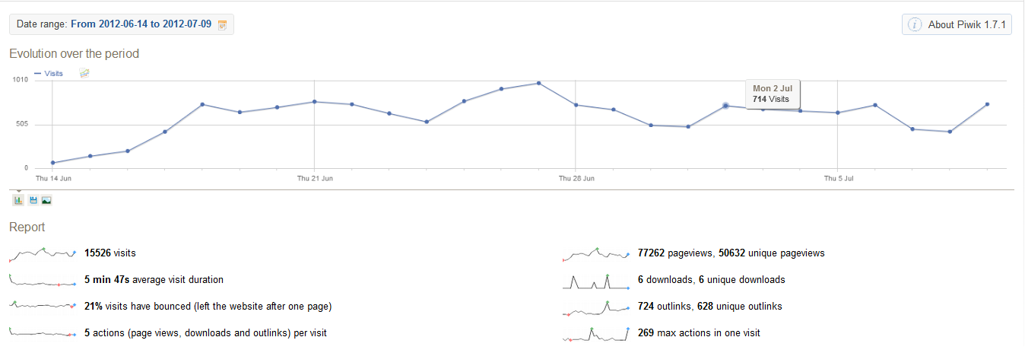
WEBSTORE TRAFFIC

Slide 14
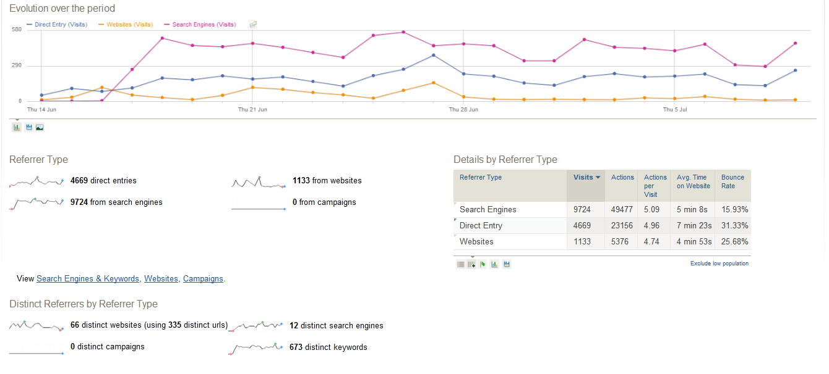
WEBSTORE TRAFFIC

Slide 15
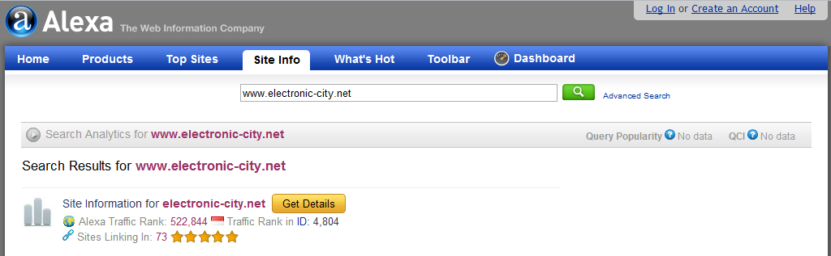
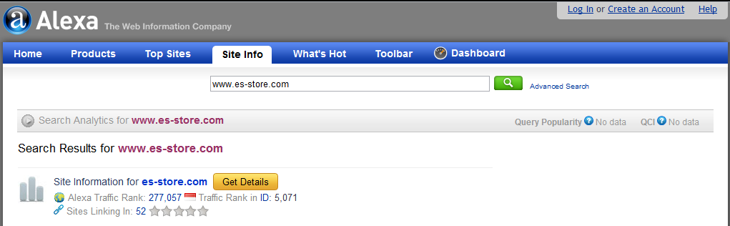
WEBSTORE RANKING

Slide 16

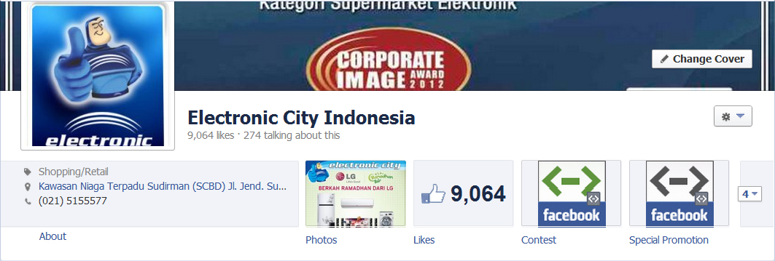
BEFORE
NOW 6/7/2012

Slide 17
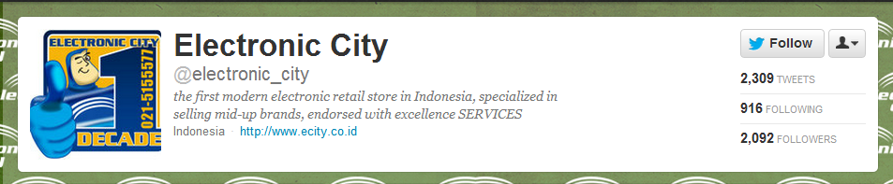
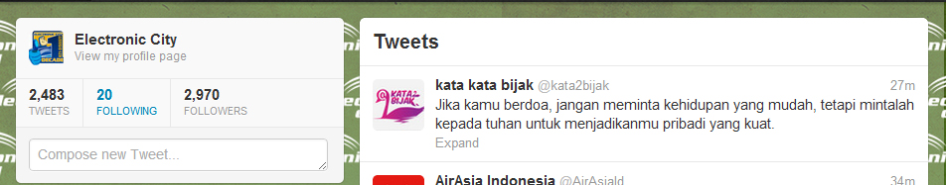
BEFORE
NOW 6/7/2012

Slide 18
PENDINGS
EC WEBSTORE
PAYMENT METHODS :
TRANSFER (JATIS)
CREDIT (KREDIT PLUS, FIF, ADIRA)
CREDIT CARD
DEBIT ( KLIKPAY)
EC BLOG ( COMMUNITY & REVIEW PRODUCT )
EC FORUM ( COMMUNITY FOR COMPLAIN AND INPUT )
CURRENT PENDINGS :
BCA INTEGRATION
JNE
CC PAYMENT METHODS

Slide 19
SOCIAL MEDIA PLANNING
WEEKS | EVENT | KPI | PRIZES
1 | BLOGGER EVENT | 5000 Followers & 5000 Fans | 3 Category, (Gadget, Auvi, Cameras) & Contract as Reviewer
2 | EVENT WAIT
3 | EVENT WAIT
4 | SURVEY REAL/COMMERCE STORE | 2000 Followers & 2000 Fans | Gadget & Auvi
5 | EVENT WAIT
6 | EVENT WAIT
7 | POINT GAMES | 5000 Followers & 5000 Fans | Gadget & Auvi
8 | EVENT WAIT
9 | EVENT WAIT
10 | HASHTAG EVENT | 2000 Followers & 2000 Fans | Vouchers & Gadget
11 | EVENT WAIT
12 | VIDEO IKLAN EC COMPETITION | 2000 Followers & 2000 Fans | Tablet & Money
13 | EVENT WAIT
14 | EVENT WAIT

Slide 20
SOCIAL MEDIA DAILY
TOPICS | MON | TUE | WED | THU | FRI | SAT | SUN
TIPS AND TRICKS | √ |  | √ |  |  |  | √
HUMOUR |  | √ |  |  | √ | √
CHIT CHAT | √ | √ | √ | √ | √ | √ | √
NEW TRENDS |  |  | √ |  |  |  | √
MOVIES | √
OLD FACT |  | √ |  | √
HEALTH |  |  |  |  | √ | √
LIFESTYLE |  |  |  | √
PROMOTION | √ | √ | √ | √ | √ | √ | √

Slide 21
WEBSTORE PLANNING
STRATEGY | OCT |  |  |  | NOV |  |  |  | DEC |  |  |  | JAN |  |  |  | FEB |  |  |  | MAR |  |  |  | KETERANGAN
 | 1 | 2 | 3 | 4 | 1 | 2 | 3 | 4 | 1 | 2 | 3 | 4 | 1 | 2 | 3 | 4 | 1 | 2 | 3 | 4 | 1 | 2 | 3 | 4
PAYMENT
PAYMENT GATEWAY (BCA CC) | √ | √ | √ | √ | √ | √ | √ | √ | √ | √ | √ | √ | √ | √ | √ | √ | √ | √ | √ | √ | √ | √ | √ | √ | FINISH
JNE | ? | ? | ? | ? | ? | ? | ? | ? |  |  |  |  |  |  |  |  |  |  |  |  |  |  |  |  | MASIH PROSES PKS
JATIS TRANSFER ROUTING | ? | ? | ? | ? | ? | ? | ? | ? |  |  |  |  |  |  |  |  |  |  |  |  |  |  |  |  | PROSES PENJAJAKAN
KLIKPAY | ? | ? | ? | ? | ? | ? | ? | ? |  |  |  |  |  |  |  |  |  |  |  |  |  |  |  |  | PROSES PENJAJAKAN
KREDIT PLUS/FIF/ADIRA | ? | ? | ? | ? | ? | ? | ? | ? |  |  |  |  |  |  |  |  |  |  |  |  |  |  |  |  | PROSES PENJAJAKAN
BLOG
AUVI |  |  |  |  |  |  |  |  |  |  |  |  |  |  |  |  |  |  |  |  |  |  |  |  | PEMBUATAN BLOG DIMULAI
GADGET |  |  |  |  |  |  |  |  |  |  |  |  |  |  |  |  |  |  |  |  |  |  |  |  | SETELAH EVENT
CAMERA |  |  |  |  |  |  |  |  |  |  |  |  |  |  |  |  |  |  |  |  |  |  |  |  | BLOGGER SELESAI
FORUM
FORUM INTEGRATION |  |  |  |  |  |  |  |  |  |  |  |  |  |  |  |  |  |  |  |  |  |  |  |  | UNTUK KOMUNITAS, COMPLAIN
BRANDING
FORUM (KASKUS) |  |  |  |  |  |  |  |  |  |  |  |  |  |  |  |  |  |  |  |  |  |  |  |  | BRANDING LEWAT FORUM
DISDUS |  |  |  |  |  |  |  |  |  |  |  |  |  |  |  |  |  |  |  |  |  |  |  |  | EVOUCHER (REJECTED CAUSE OF PRICE)
KATALOG PROMO |  |  |  |  |  |  |  |  |  |  |  |  |  |  |  |  |  |  |  |  |  |  |  |  | PROMO KATALOG
MOBILE APPS
iOS & ANDROID |  |  |  |  |  |  |  |  |  |  |  |  |  |  |  |  |  |  |  |  |  |  |  |  | APPLE IPAD, IPHONE, ANDROID PHONE
BLACKBERRY |  |  |  |  |  |  |  |  |  |  |  |  |  |  |  |  |  |  |  |  |  |  |  |  | -

Slide 22
E-COMMERCE MARKET
SURVEYS AND MARKET DEMANDS

Slide 23
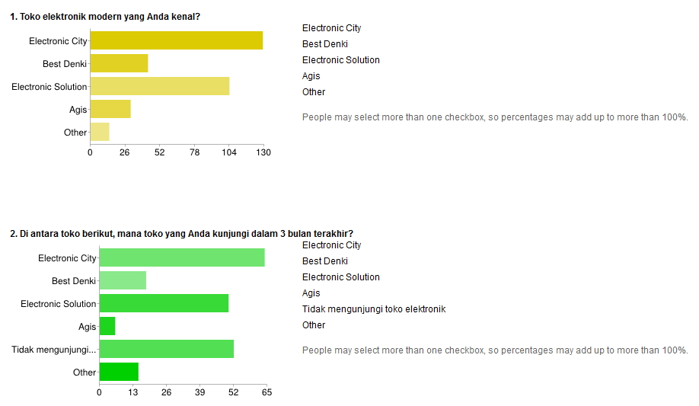
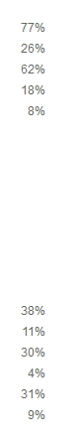
Our Market

Slide 24
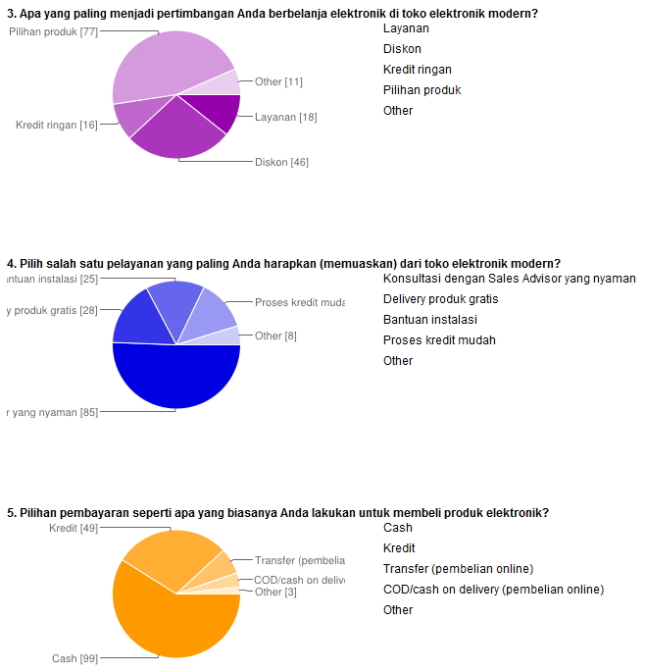
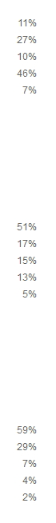
Our Market

Slide 25
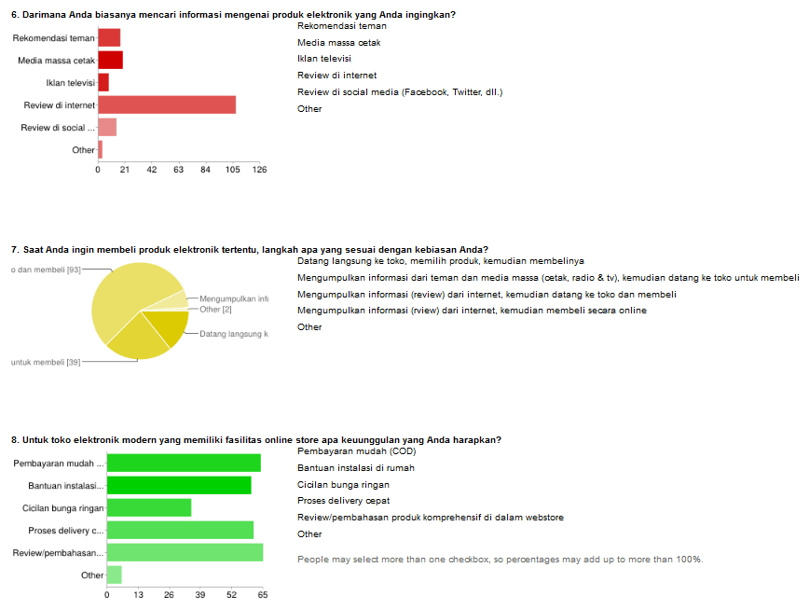
Our Market

Slide 26







SOCIAL MEDIA

Slide 27
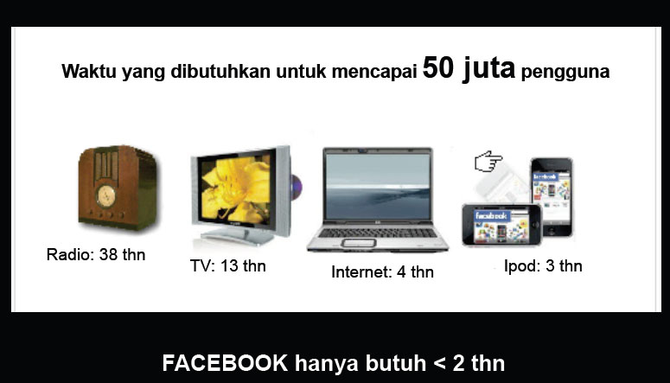
SOCIAL MEDIA

Slide 28
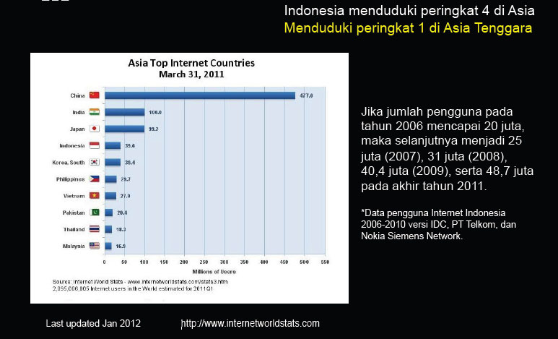
SOCIAL MEDIA

Slide 29
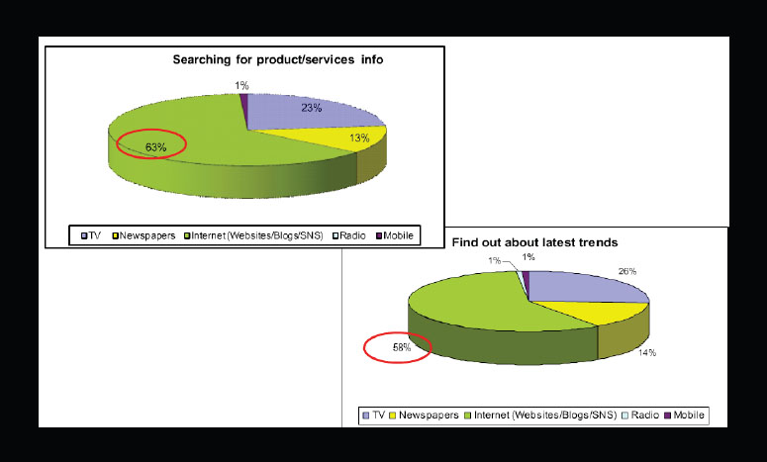
SOCIAL MEDIA

Slide 30

SOCIAL MEDIA

Slide 31

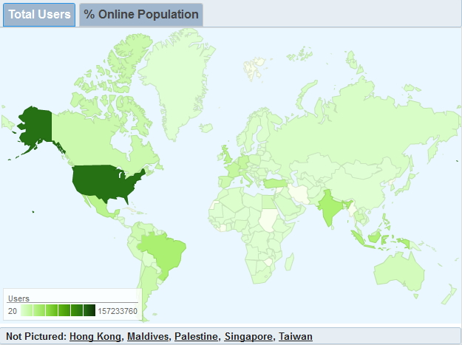
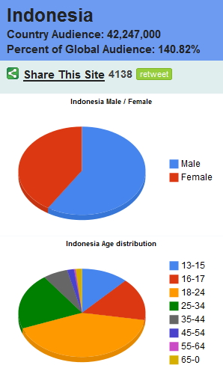
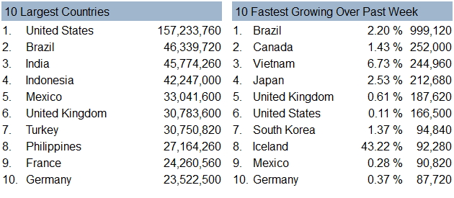
SOCIAL MEDIA

Slide 32
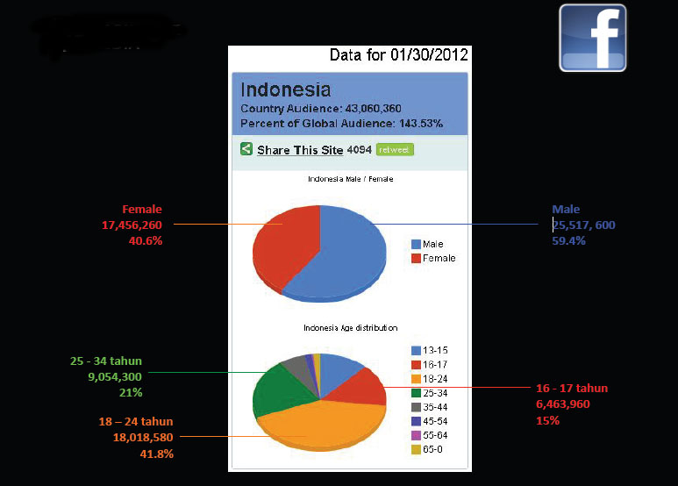
SOCIAL MEDIA

Slide 33
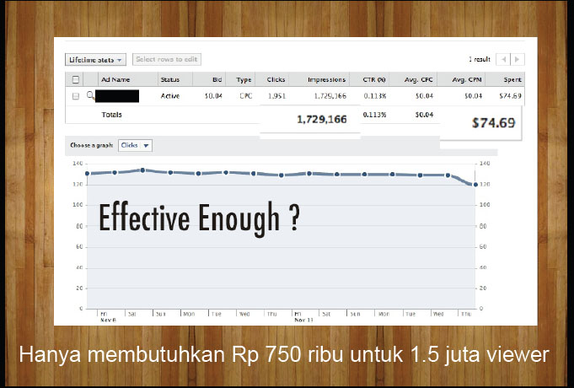
SOCIAL MEDIA

Slide 34
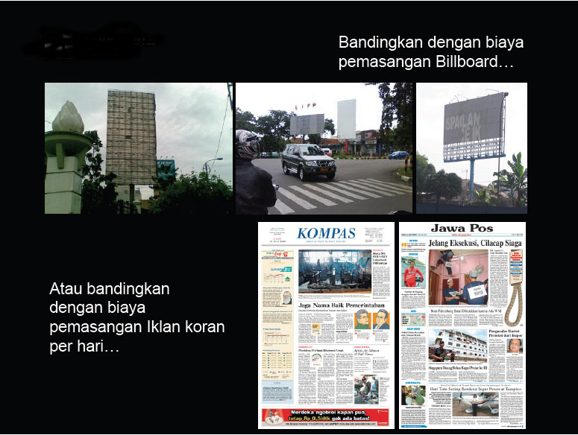
SOCIAL MEDIA

Slide 35

SOCIAL MEDIA

Slide 36
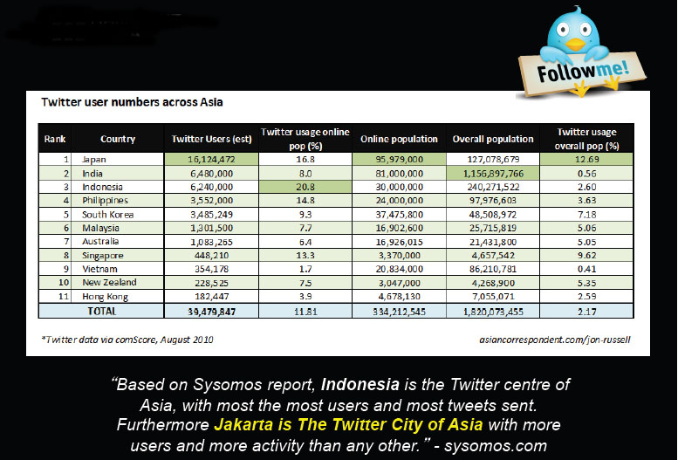
SOCIAL MEDIA

Slide 37
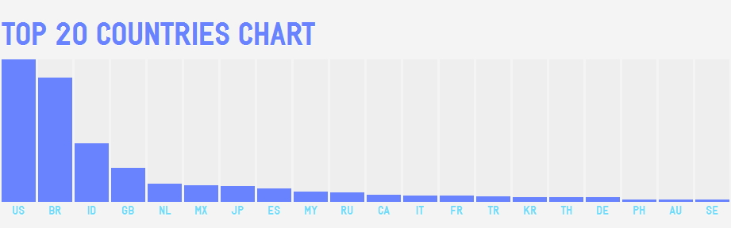
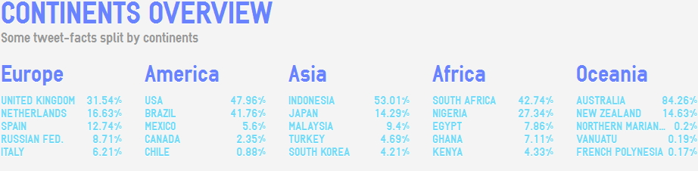

SOCIAL MEDIA

Slide 38
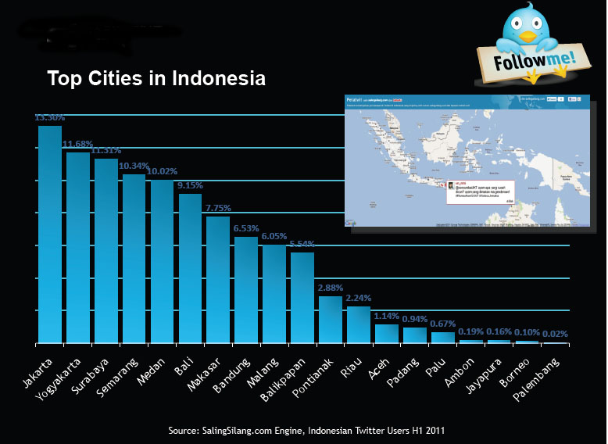
SOCIAL MEDIA

Slide 39
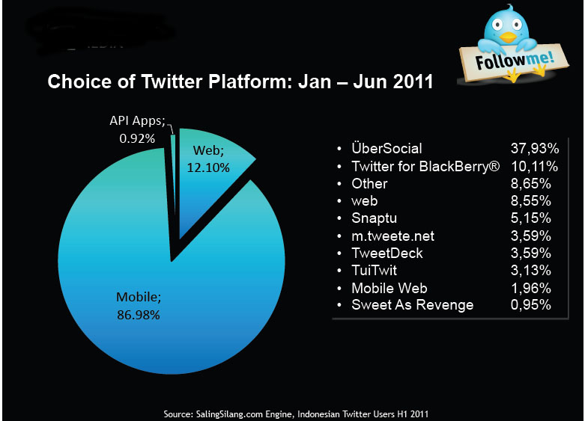
SOCIAL MEDIA

Slide 40
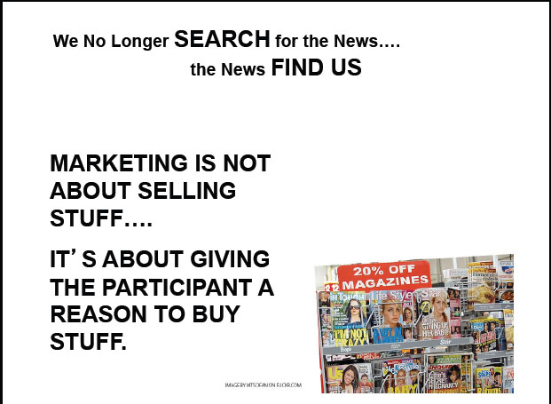
SOCIAL MEDIA

Slide 42
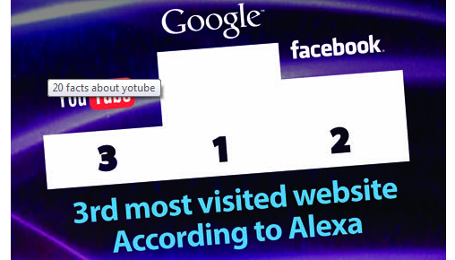

Slide 43


Slide 44
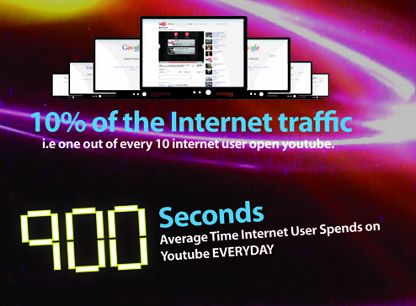

Slide 45
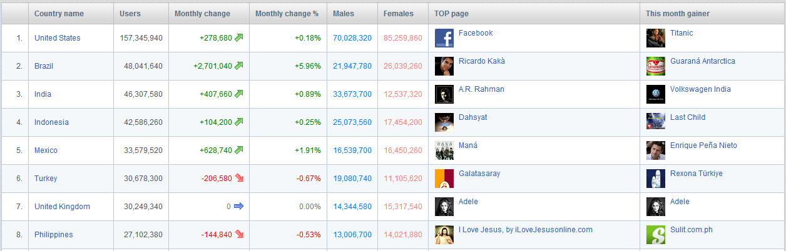

Slide 46

YOUTUBE ONLY
VIDEO SHARING

Slide 47



VISUAL MARKETING
EXAMPLE
OVER 160 MILLION VIEWER,
CAN YOU FIGURE IF
THE CONVERSION RATE IS 0.1%
HOW MUCH HE MAKES?

Slide 48

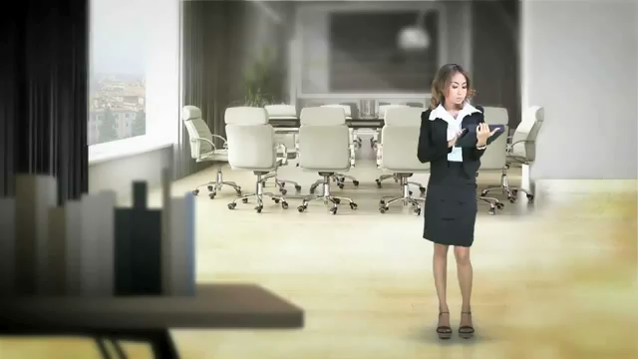
Youtube ES ads for es-Store.com

Slide 49

SOCIAL MEDIA

Slide 50
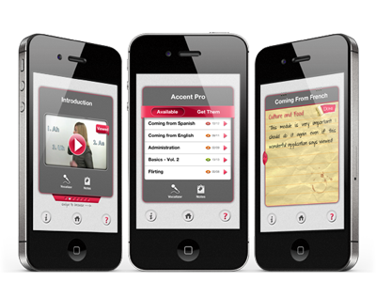
MOBILE APPS

Slide 51
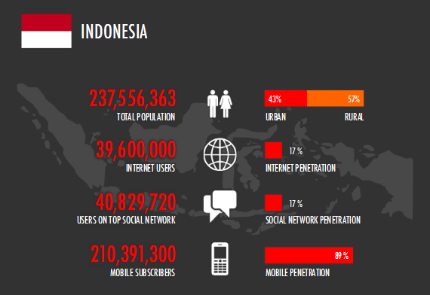
MOBILE APPS

Slide 52
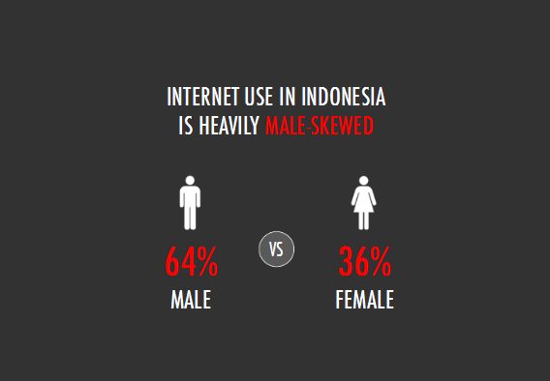
MOBILE APPS

Slide 53
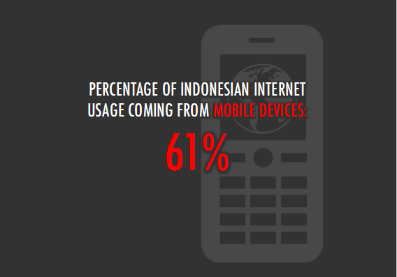
MOBILE APPS

Slide 54
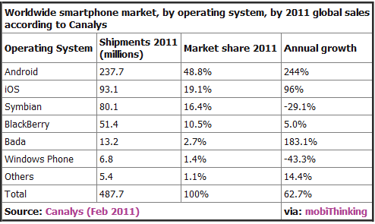
MOBILE APPS

Slide 55
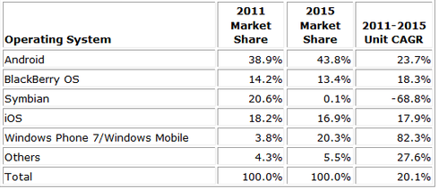
MOBILE APPS

Slide 56
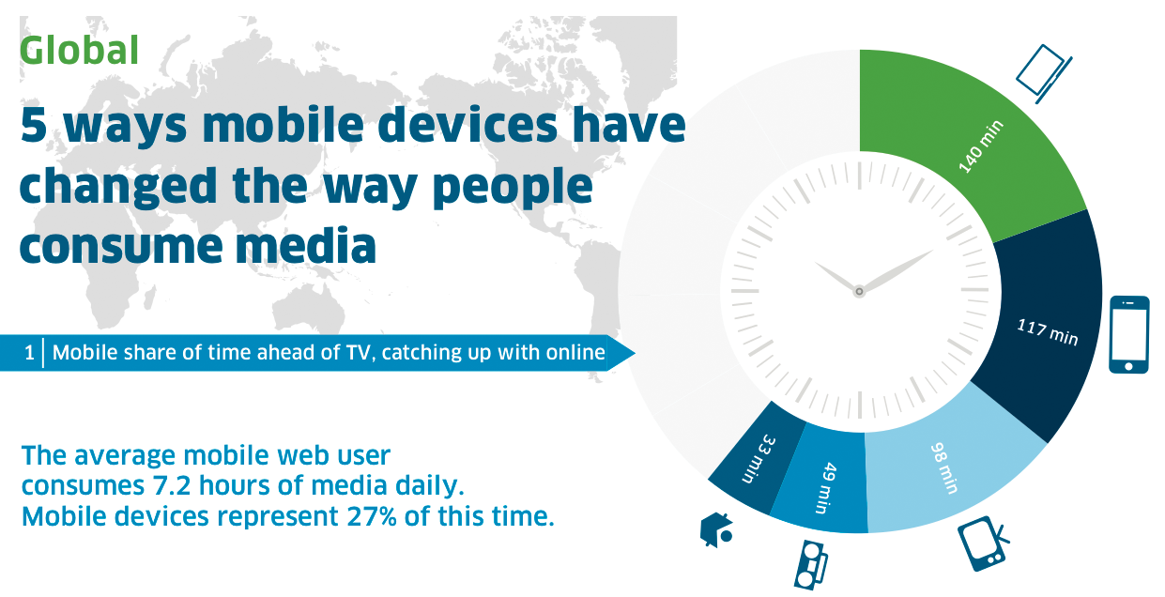
MOBILE APPS

Slide 57
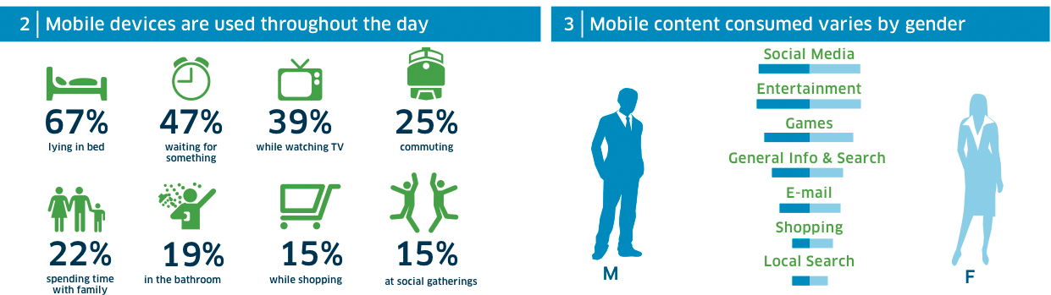
MOBILE APPS

Slide 58
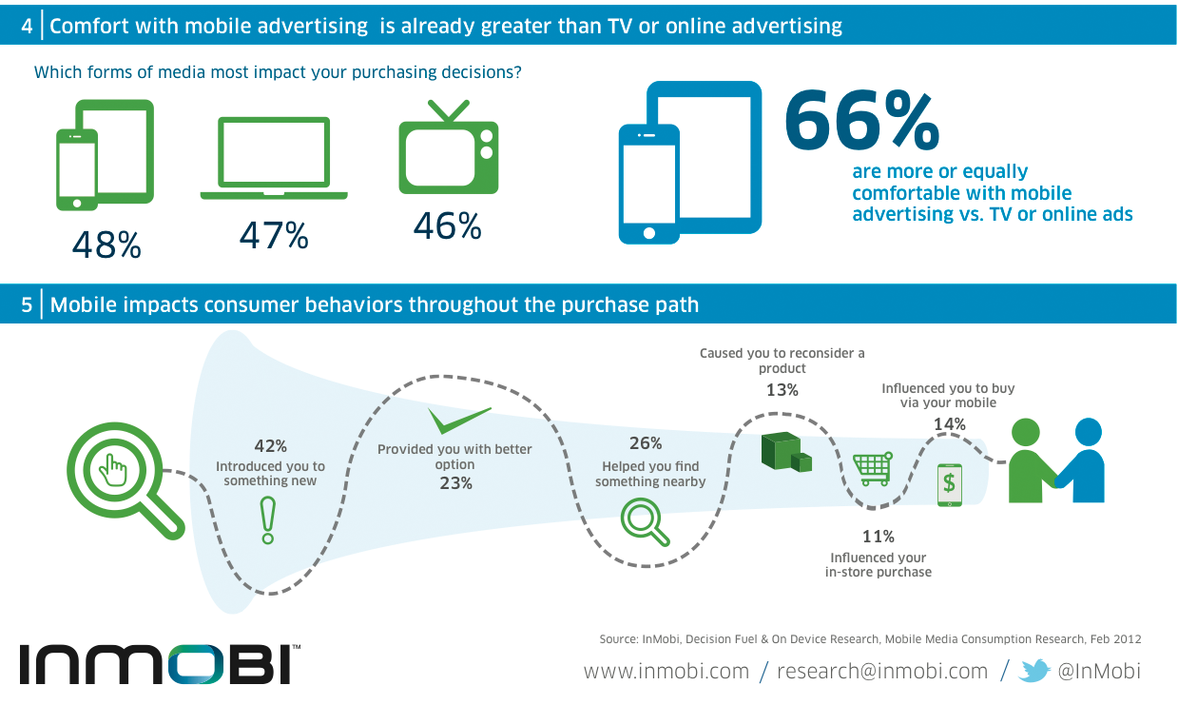
MOBILE APPS

Slide 59
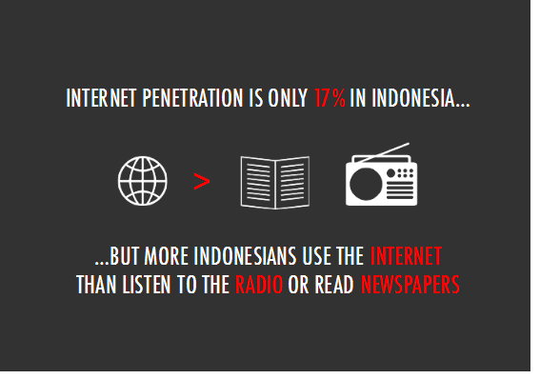
MOBILE APPS

Slide 60
THANK YOU

